Slide 1

MIS 637-B
PHISHING DETECTOR
Name

Slide 2
Table of Content
1
Introduction
Data Preprocessing
Exploratory Data Analysis
Model Building & Training
Model Comparison
Conclusion
2
3
4
5
6

Slide 3

Introduction
Phishing is a malicious practice where attackers deceive individuals into sharing sensitive information such as passwords, credit card numbers, or personal data by posing as a trustworthy entity.
Detecting and preventing phishing attacks is crucial for safeguarding individuals and organizations against cyber threats.
1
2
3
With the increasing sophistication of phishing techniques, traditional rule-based approaches are often insufficient. Machine learning offers powerful tools to analyze large datasets and identify patterns indicative of phishing behavior, enabling more effective detection and mitigation strategies.
4
In this project, we've utilized a dataset containing features extracted from URLs to classify phishing websites. We'll leverage Python libraries such as Polars for data manipulation, Matplotlib and Seaborn for visualization, and various machine learning algorithms implemented in scikit-learn and other libraries for model building and evaluation.
5
6

Slide 4
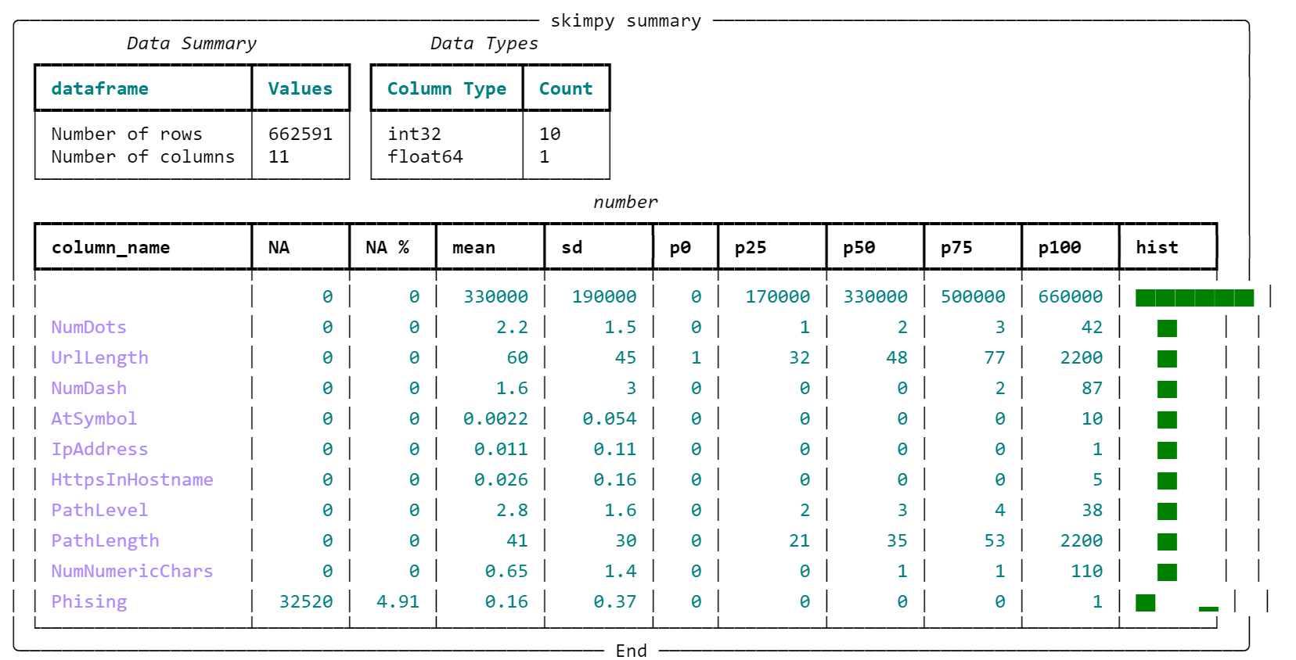
Data Preprocessing
1
We begin with loading the dataset containing features extracted from URLs using the Polars library. The dataset consists of the following
1
2
3
4
5
6

Slide 5
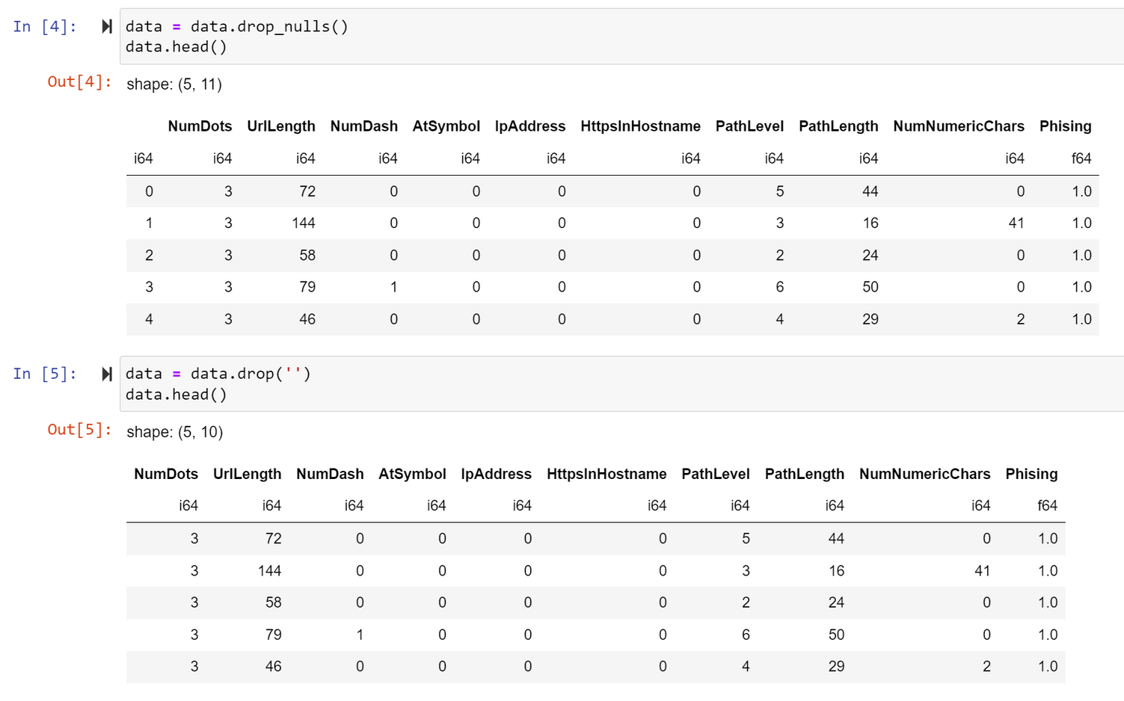
Data Preprocessing
1
We handle missing values and drop irrelevant columns to focus on relevant features for phishing detection.
2
3
4
5
6

Slide 6
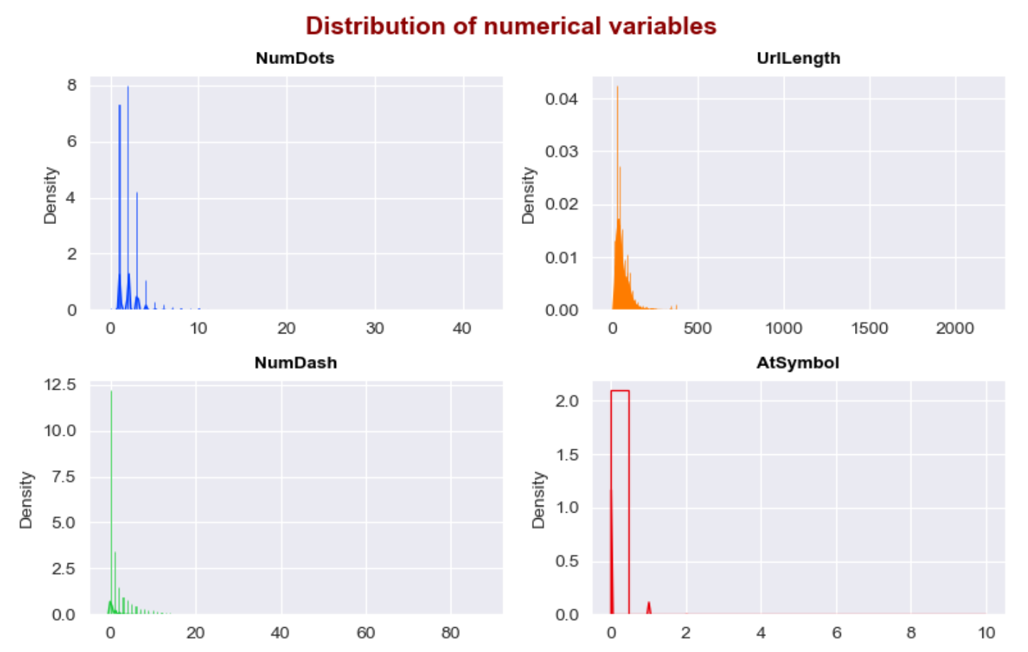
Exploratory Data Analysis
Distribution of Numerical Variables
1
This provides insights into the range and shape of each variable's distribution.
2
3
4
5
6

Slide 7
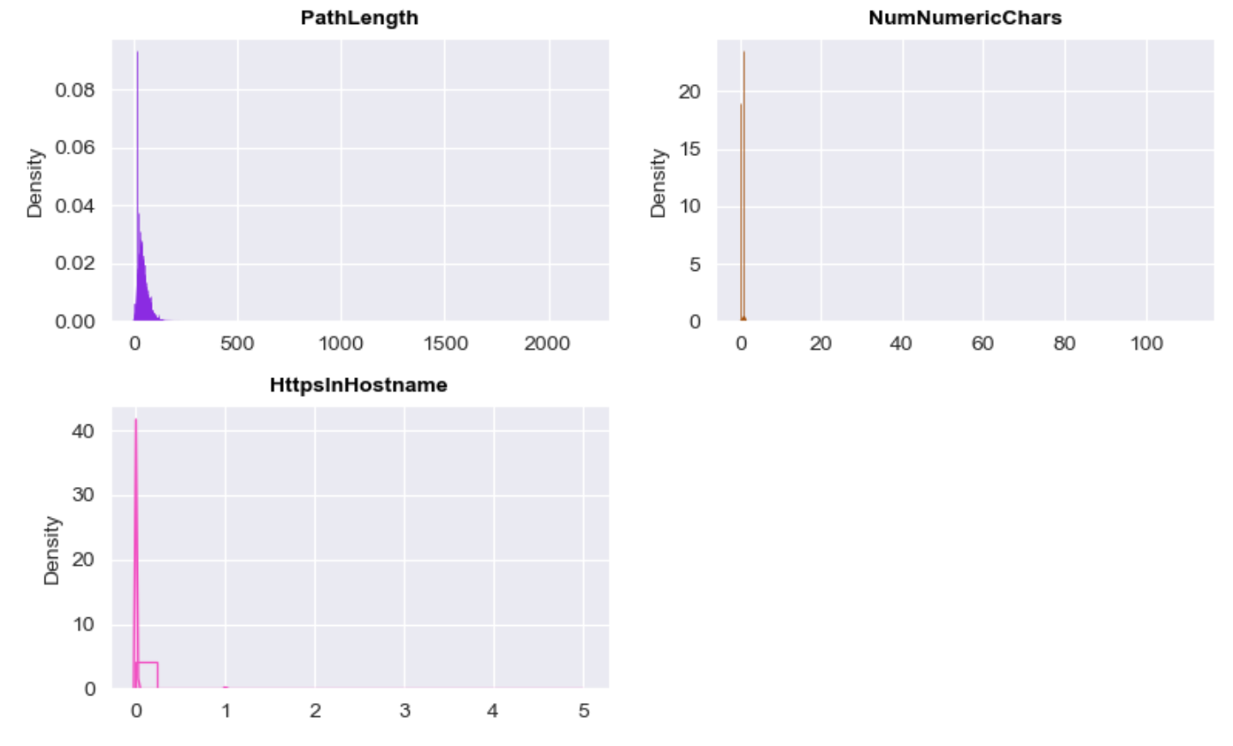
Exploratory Data Analysis
Distribution of Numerical Variables
1
This provides insights into the range and shape of each variable's distribution.
2
3
4
5
6

Slide 8
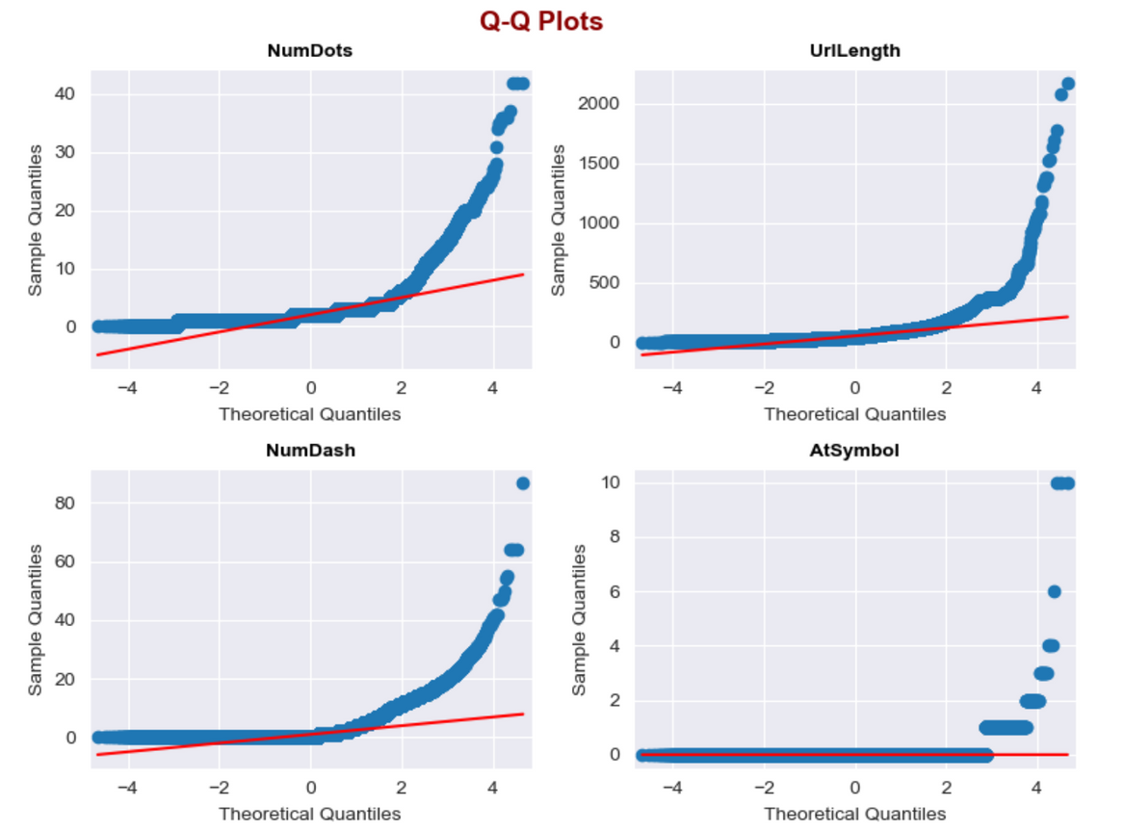
Exploratory Data Analysis
Quantile-Quantile Plot
1
These plots compare the observed distribution of data with the expected normal distribution, identifying deviations from normality.
2
3
4
5
6

Slide 9
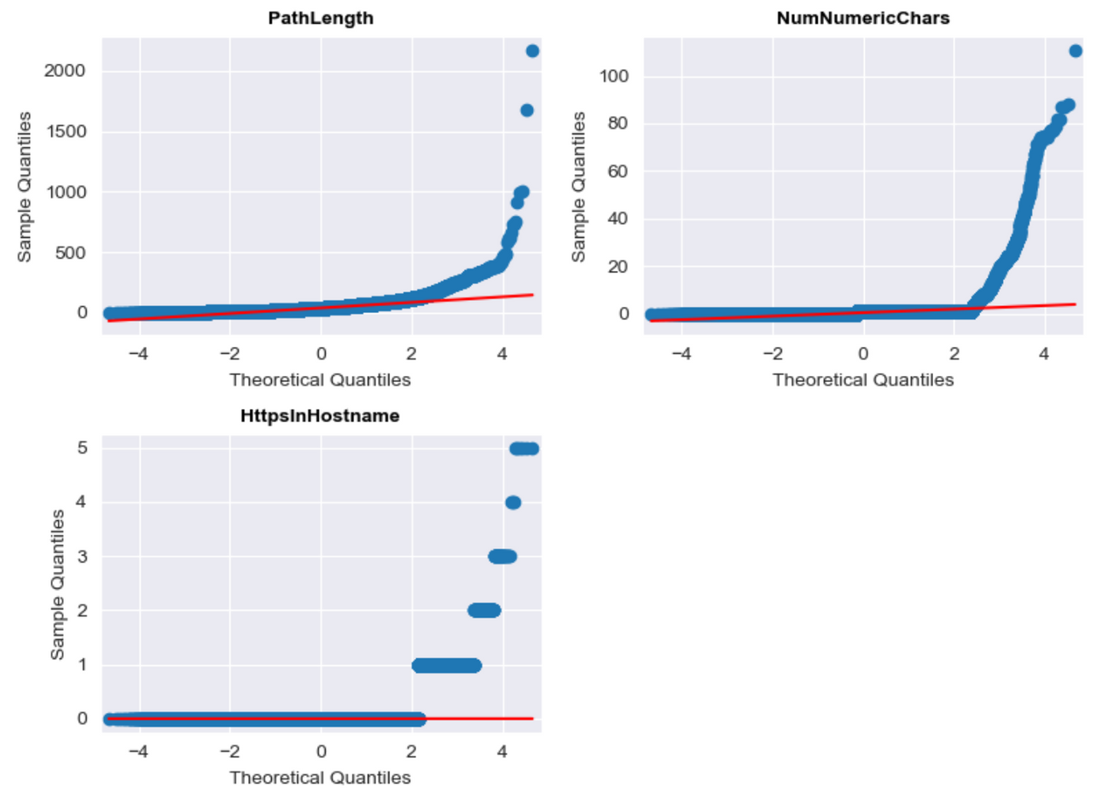
Exploratory Data Analysis
Quantile-Quantile Plot
1
These plots compare the observed distribution of data with the expected normal distribution, identifying deviations from normality.
2
3
4
5
6

Slide 10
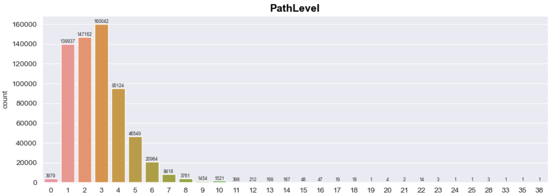
Exploratory Data Analysis
Count Plot for Categorical Variable (PathLevel)
1
This helps understand the prevalence of various URL path levels.
2
3
4
5
6

Slide 11
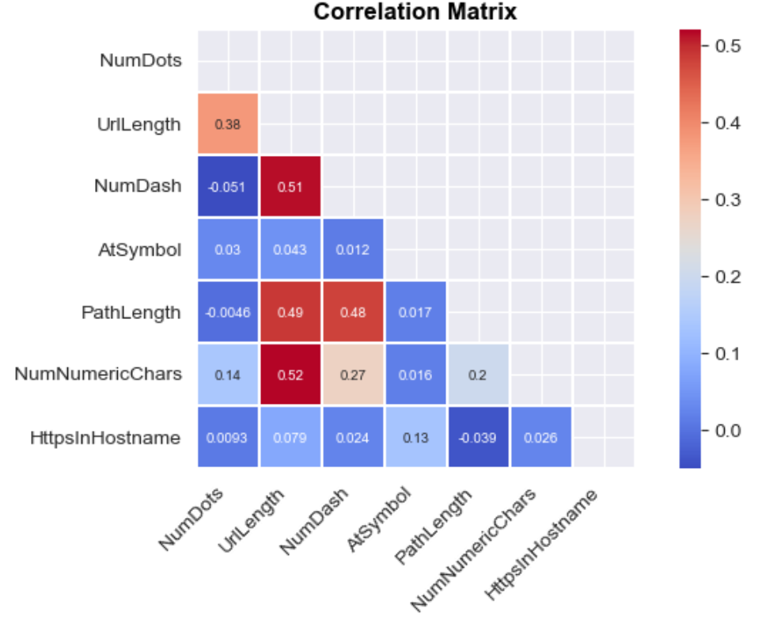
Exploratory Data Analysis
Correlation Heat Matrix
1
This analysis helps identify potential multicollinearity among features.
2
3
4
5
6

Slide 12

Model Building & Training
We use several classification models to predict phishing websites:
Logistic Regression
Random Forest
Extra Trees
Hist Gradient Boosting
XGBoost
LightGBM
CatBoost
1
Each model offers unique advantages in handling the dataset's characteristics, ranging from interpretability to robustness against overfitting.
2
3
4
The dataset is split into training and testing sets to evaluate model performance. Models are trained using the training set, and hyperparameters are tuned using techniques like cross-validation to optimize performance.
5
6
Trained models are evaluated using appropriate evaluation metrics such as F2 Score, precision, recall, and accuracy.
Performance on both the training and testing sets is assessed to ensure the model generalizes well to unseen data.

Slide 13
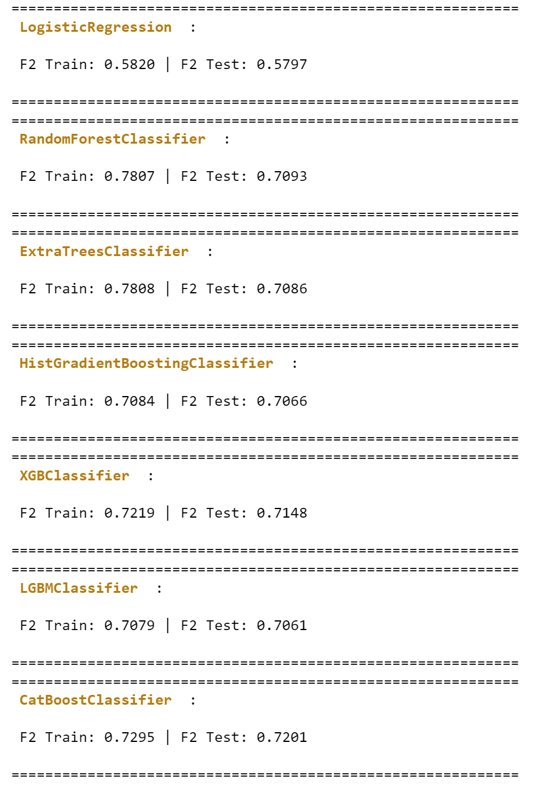
Model Comparison
Comparison on F2 Scores
1
F2 Scores offer a balanced evaluation metric that considers both precision and recall, providing insight into the models' overall performance in detecting phishing websites.
2
3
Random Forest, Extra Trees, and CatBoost classifiers demonstrate the highest F2 Scores on the test set, indicating their effectiveness in accurately classifying phishing websites while minimizing false positives and false negatives.
4
5
6

Slide 14
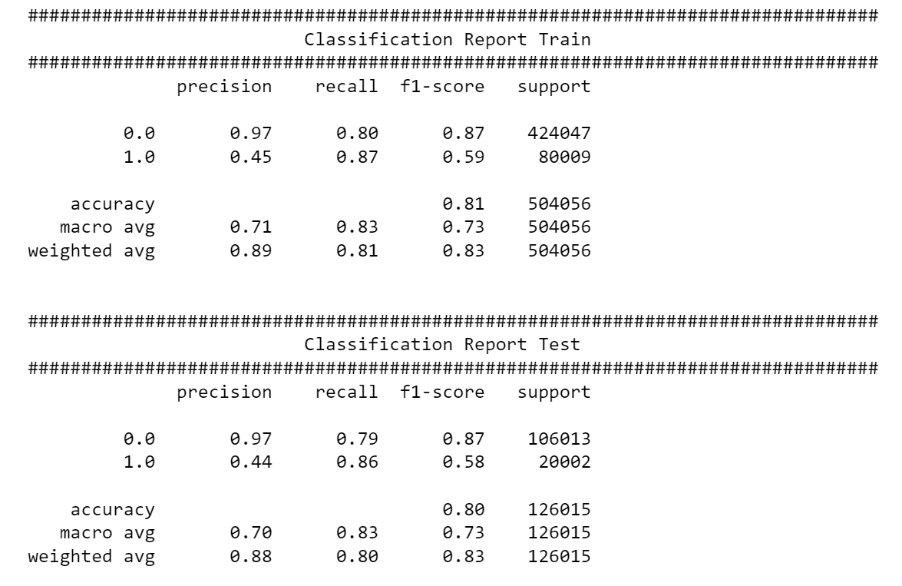
Model Comparison
Comparison of precision and recall
1
These metrics provides further insights into the models' ability to correctly classify phishing websites and legitimate URLs.
2
3
4
5
6

Slide 15
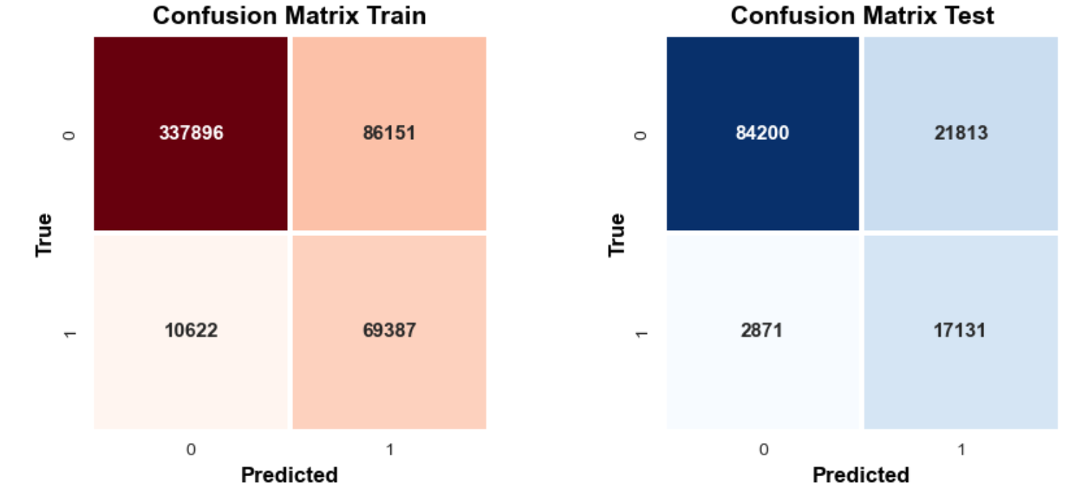
Model Comparison
Comparison on Confusion Matrix
1
The confusion matrix for the training set provides insights into how well the models perform on data they were trained on and for the test set evaluates the models' ability to generalize to unseen data
2
3
4
5
6

Slide 16
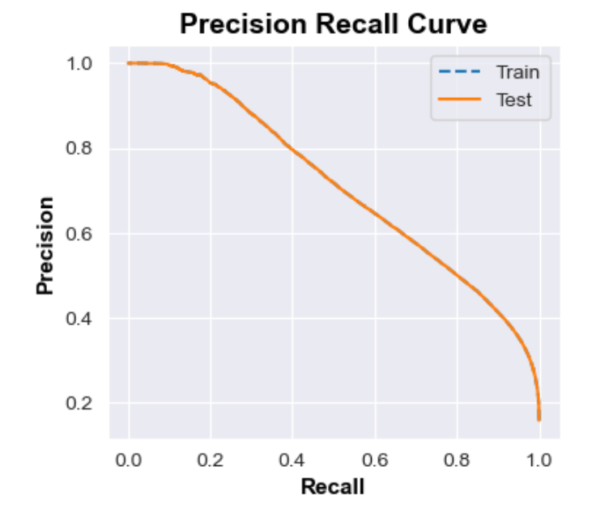
Model Comparison
Precision Recall Curve
1
The Precision-Recall curve illustrates the trade-off between precision and recall for different classification thresholds. Precision measures the proportion of true positives among all instances predicted as positive, while recall measures the proportion of true positives identified correctly.
2
3
4
5
6

Slide 17
Conclusion
1
The successful detection of phishing websites is crucial for mitigating cybersecurity risks and protecting sensitive information.
Implementing robust phishing detection systems powered by advanced machine learning techniques can significantly enhance cybersecurity defenses, enabling organizations to proactively identify and mitigate potential security threats.
Our analysis of various machine learning models for phishing detection reveals promising results, with several classifiers demonstrating high accuracy in distinguishing between legitimate and malicious URLs.
Models such as Random Forest, Extra Trees, and CatBoost exhibit superior performance metrics, including precision, recall, and F2 Score, indicating their effectiveness in accurately classifying phishing websites while minimizing false positives and false negatives.
2
3
4
5
6

Slide 18

1
2
3
4
5
Thank you
6
7
8
9

